Slide 1

Shivkumar Biradar
Biradar Infotech Academy
Reddy complex, Mohan Market KEB Road Bidar 585401

Slide 2


Slide 3
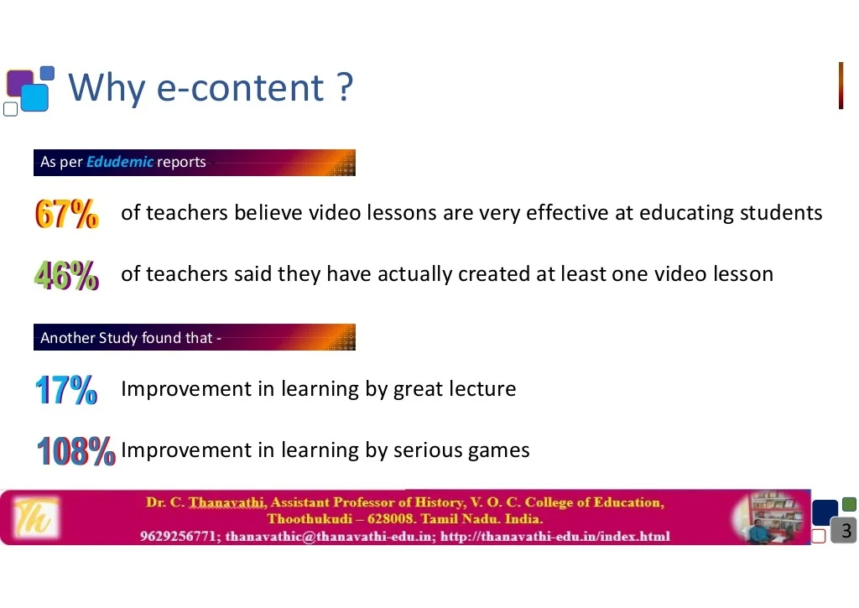
Biradar Infotech Academy
Reddy complex,Mohan Market KEB Road Bidar 585401

Slide 4
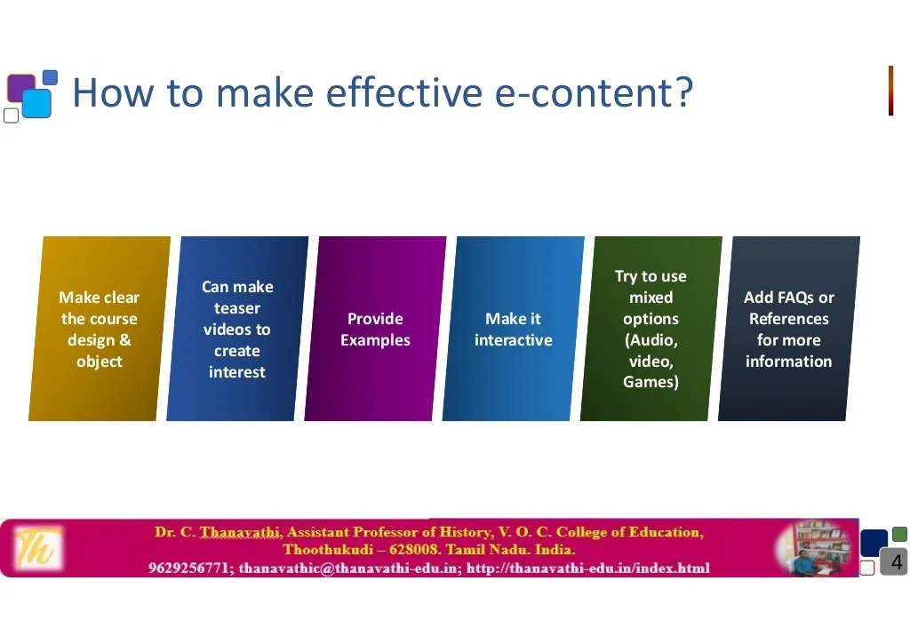
Biradar Infotech Academy
Reddy complex,Mohan Market KEB Road Bidar 585401

Slide 5
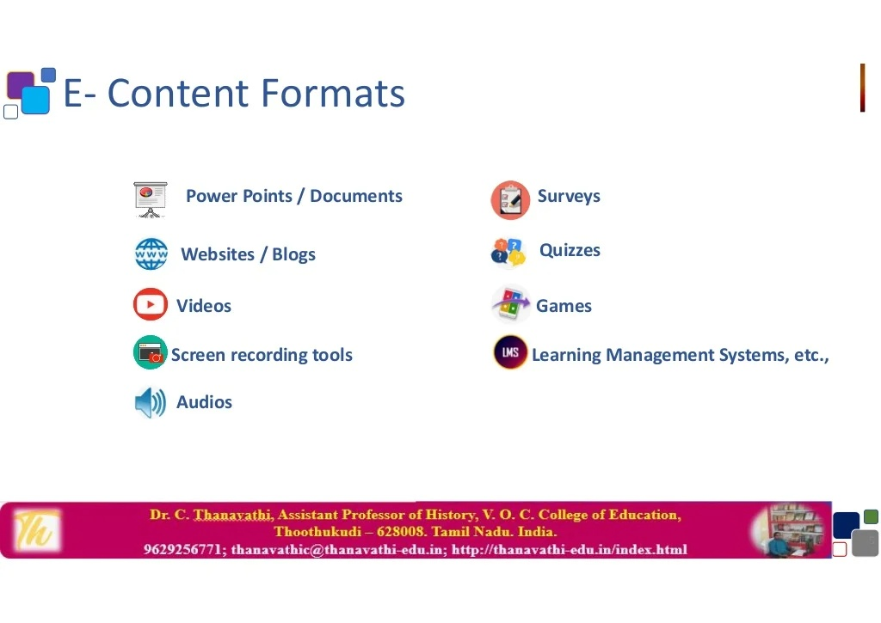
Biradar Infotech Academy
Reddy complex, Mohan Market KEB Road Bidar 585401

Slide 6

Biradar Infotech Academy
Reddy complex, Mohan Market KEB Road Bidar 585401

Slide 7
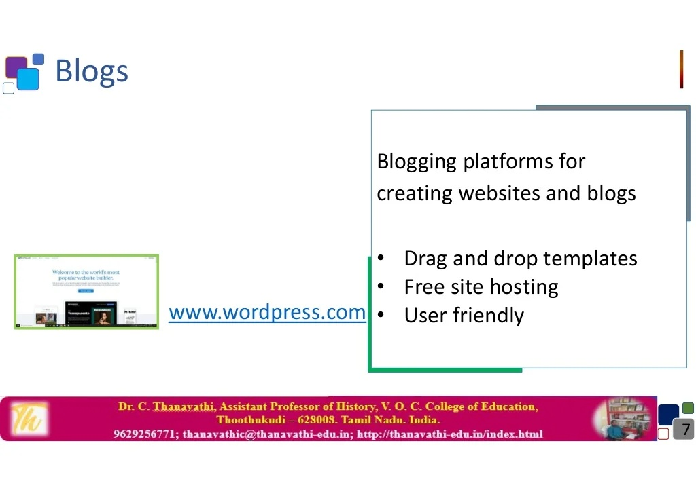
Biradar Infotech Academy
Reddy complex, Mohan Market KEB Road Bidar 585401

Slide 8
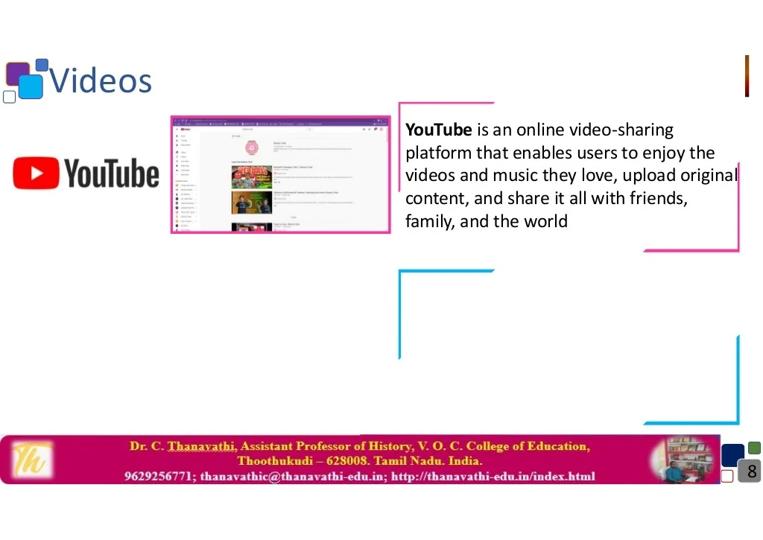
Biradar Infotech Academy
Reddy complex, Mohan Market KEB Road Bidar 585401

Slide 9

Biradar Infotech Academy
Reddy complex,Mohan Market KEB Road Bidar 585401

Slide 10

Biradar Infotech Academy
Reddy complex, Mohan Market KEB Road Bidar 585401

Slide 11
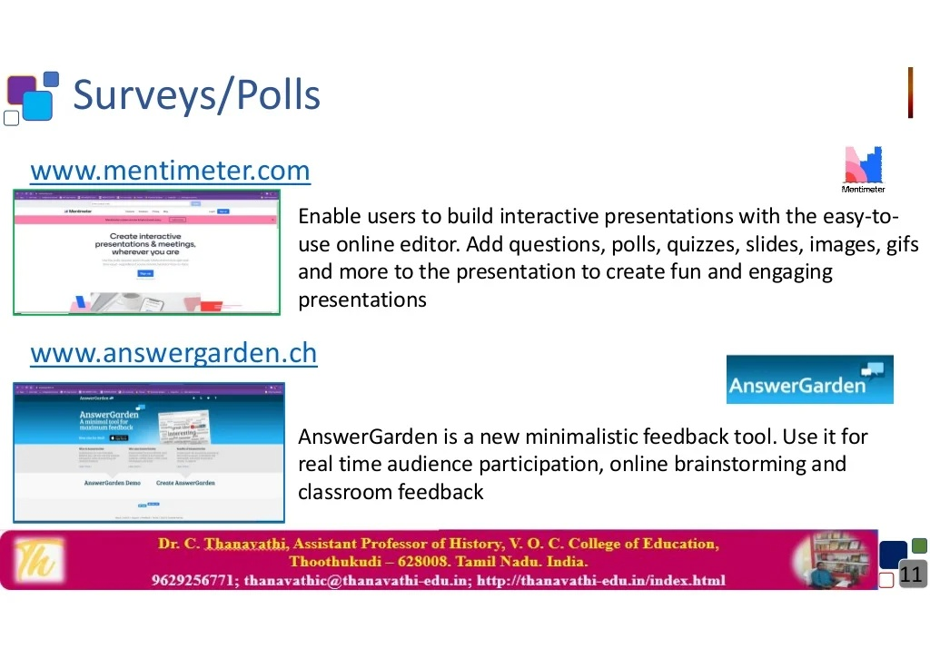
Biradar Infotech Academy
Reddy complex, Mohan Market KEB Road Bidar 585401

Slide 12
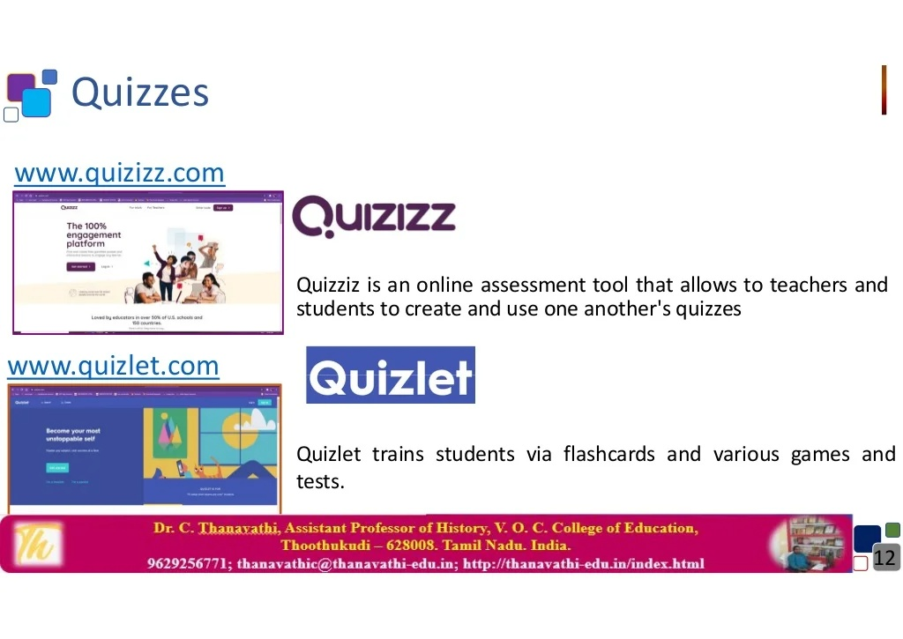
Biradar Infotech Academy
Reddy complex, Mohan Market KEB Road Bidar 585401

Slide 13

Biradar Infotech Academy
Reddy complex, Mohan Market KEB Road Bidar 585401

Slide 14

Biradar Infotech Academy
Reddy complex, Mohan Market KEB Road Bidar 585401

Slide 15
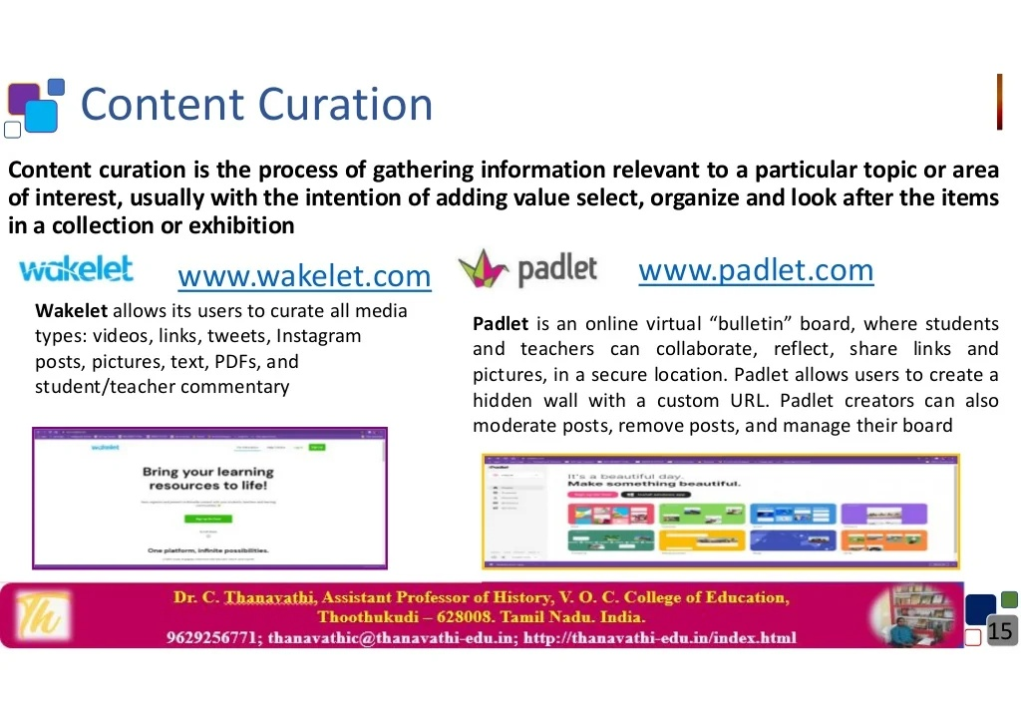
Biradar Infotech Academy
Reddy complex,Mohan Market KEB Road Bidar 585401

Slide 16

Biradar Infotech Academy
Reddy complex,Mohan Market KEB Road Bidar 585401

Slide 17

Biradar Infotech Academy
Reddy complex,Mohan Market KEB Road Bidar 585401

Slide 18
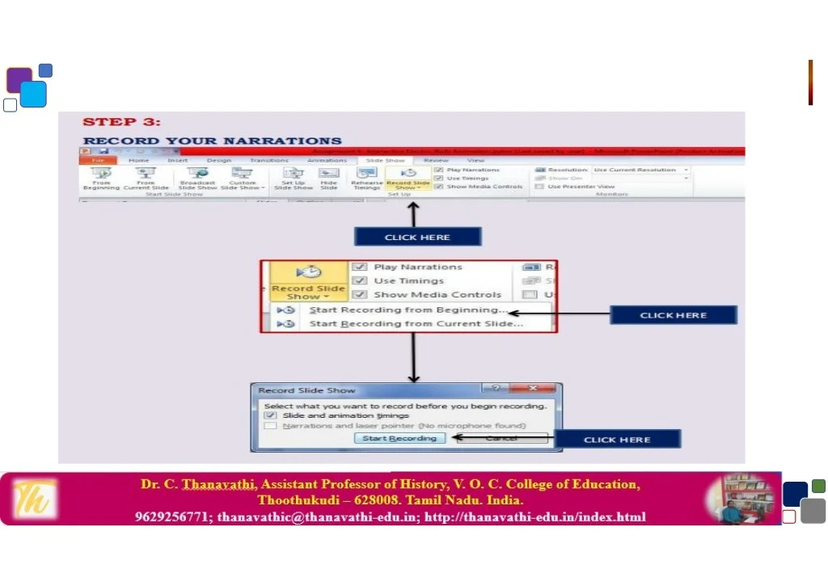
Biradar Infotech Academy
Reddy complex,Mohan Market KEB Road Bidar 585401

Slide 19
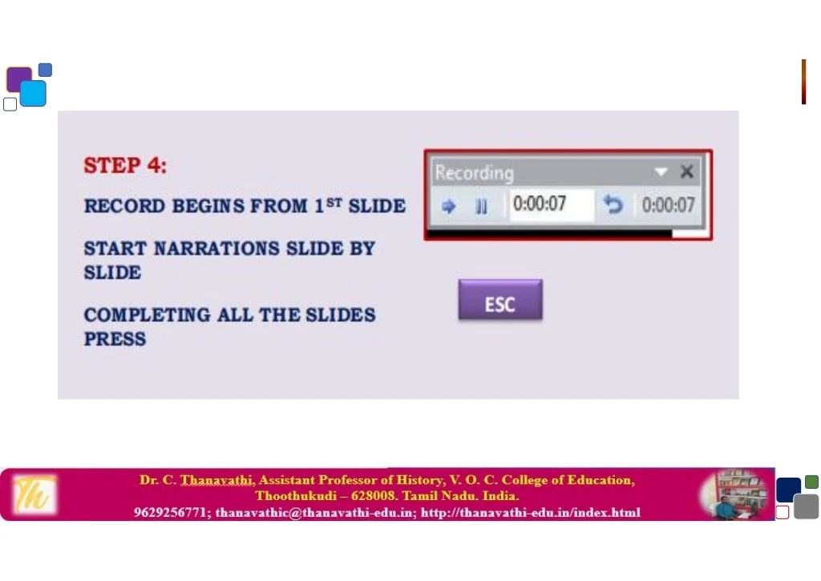
Biradar Infotech Academy
Reddy complex,Mohan Market KEB Road Bidar 585401

Slide 20
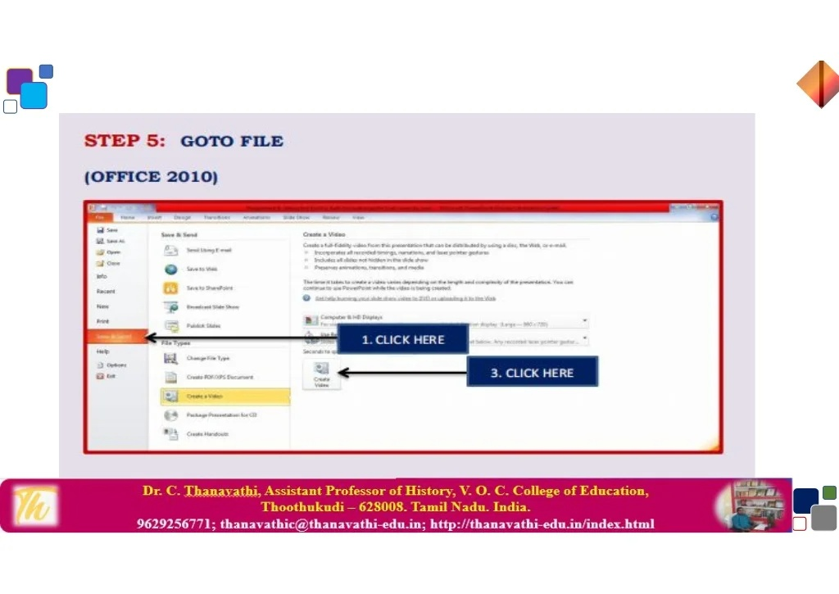
Biradar Infotech Academy
Reddy complex,Mohan Market KEB Road Bidar 585401

Slide 21
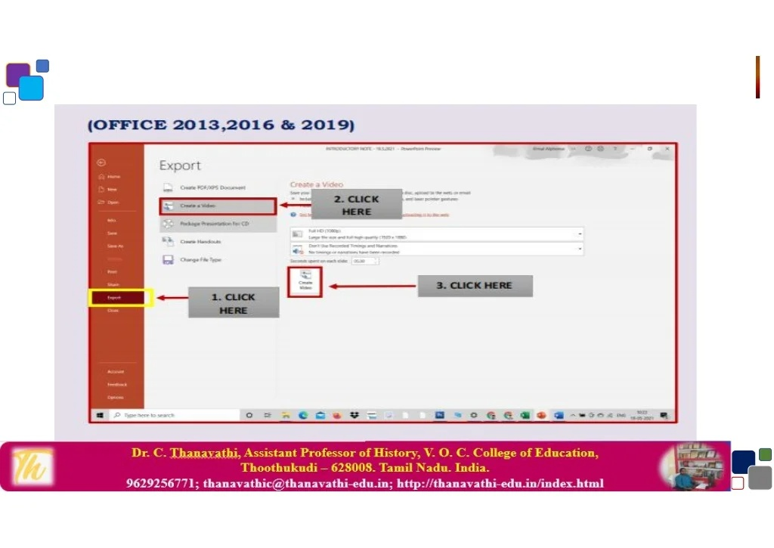
Biradar Infotech Academy
Reddy complex,Mohan Market KEB Road Bidar 585401

Slide 22
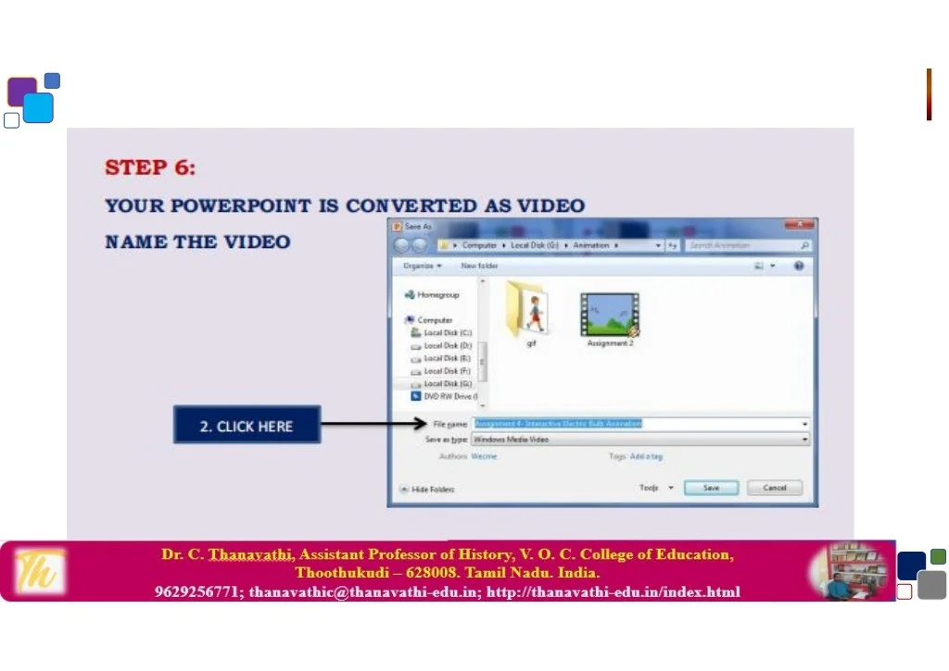
Biradar Infotech Academy
Reddy complex, Mohan Market KEB Road Bidar 585401

Slide 23

Biradar Infotech Academy
Reddy complex, Mohan Market KEB Road Bidar 585401

Slide 24

Biradar Infotech Academy
Reddy complex,Mohan Market KEB Road Bidar 585401

